Slide 1
Geometric Deep Learning
Notes:
Hi Everyone, Good

Slide 2

Geometric Deep Learning is not just about using Deep Learning methods for Geometrical Datasets likes Graphs

Slide 3
Geometry
GEOMETRON (Greek)
GEO (Earth) + Metron (Measurement)
Part of Philosophy about the Perfection of the Universe
Pythagoras
Notes:
I am doing research in Graph & its applications in NLP and medical field.

Slide 4
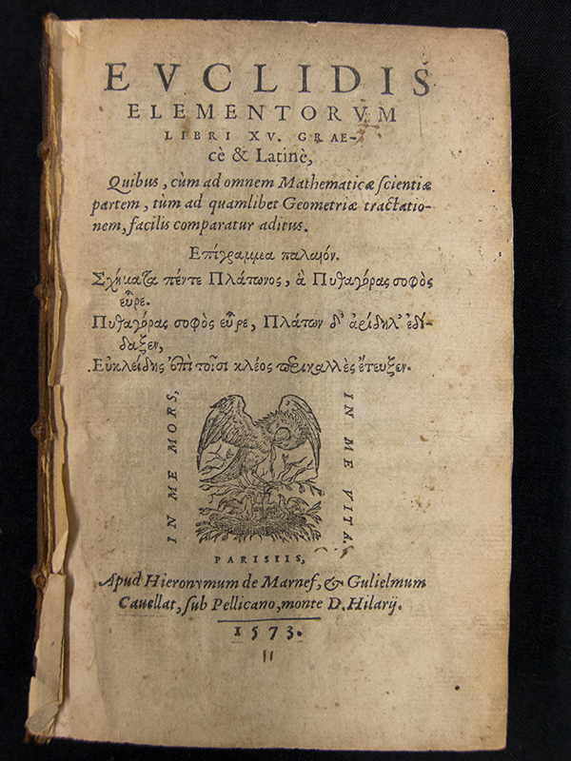
EUCLIDEAN GEOMETRY
Plane and solid geometry (2-D)
5 Axioms
Can’t Able to prove the 5th one
Book named ELEMENTS
This is the Beginning of Both Modern Geometry and Deep Learning
Notes:
The five axioms for Euclidean geometry are:
Any two points can be joined by a straight line. (This line is unique given that the points are distinct)
Any straight line segment can be extended indefinitely in a straight line.
Given any straight line segment, a circle can be drawn having the segment as radius and one endpoint as center.
All right angles are congruent.
Through a point not on a given straight line, one and only one line can be drawn that never meets the given line.
300 bc

Slide 5
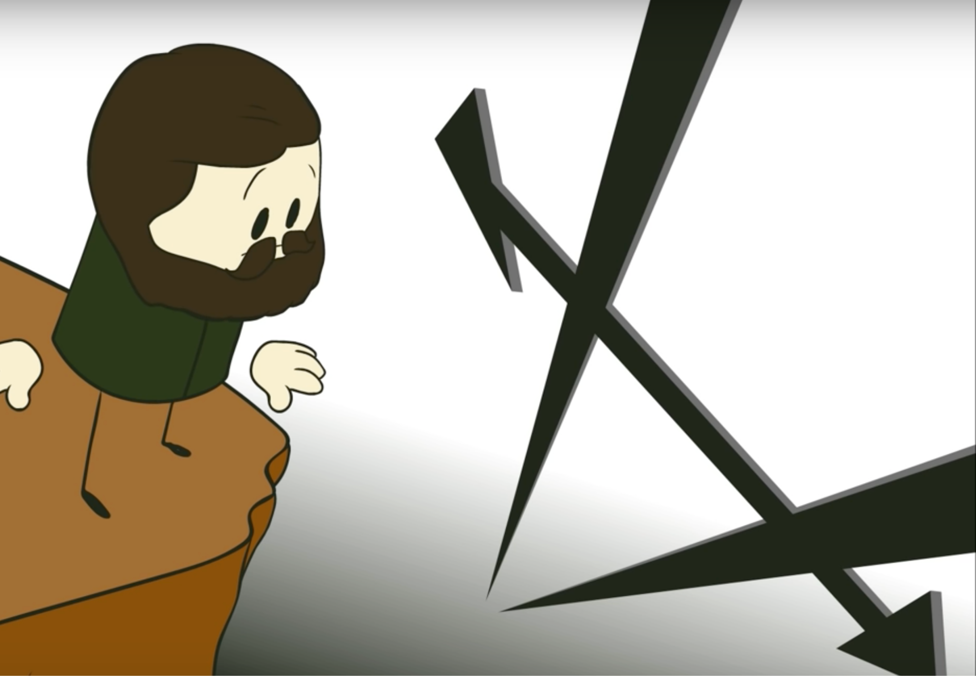
Do not try the Parallel in that Way, I know that way all along. I have measured that bottomless night, all the light and all the joy of my life went out there.
-Farcus Bulyai to his son (April 4th 1820)
Notes:
Haunted for 2000 years

Slide 6
Straight Line might not exists
and
parallel may not function the way you thought they functioned

Slide 7
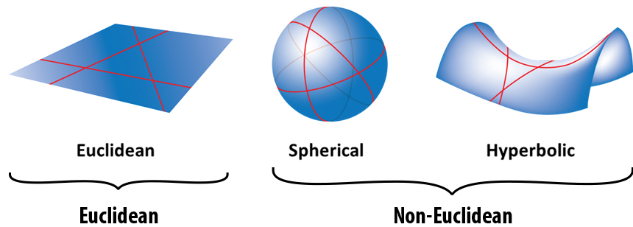
Non-Euclidean Geometry
Notes:
Euclidean - Zero Curvature - 2 D - Euclid
Spherical - Positive Curvature (Elliptical) - Theodosius of Bithynia,
Hyperbolic (Saddle) - Negative Curvature (Hyperbolic) - Nikolay Ivanovich Lobachevsky

Slide 8
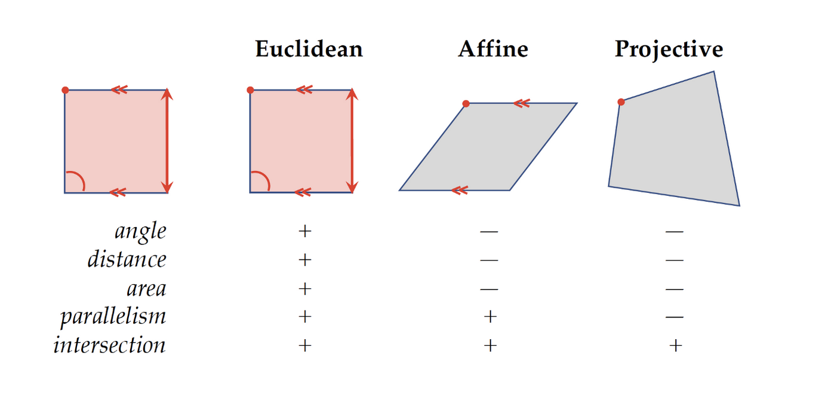
ERLANGEN PROGRAM
Felix Klein
Geometry
Study of Invariants/ Symmentries.
The Properties that remains unchanged under some class of transformations
Different Geometries could be defined by the appropriate choice of symmetry transformations formalized using language of group theory

Slide 9
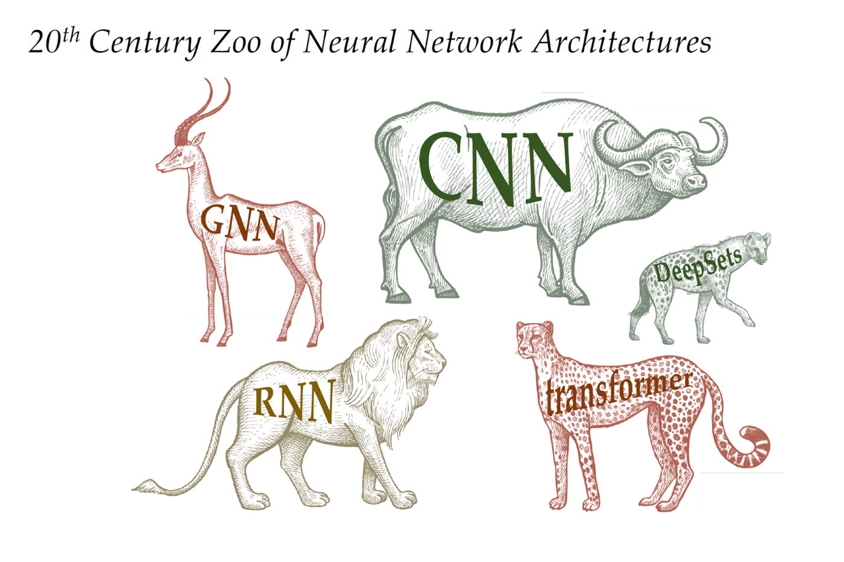
Deep Learning - Today
Several types of Neural Network Architecture for Different types of Datasets with few unifying principle.
Difficult to understand relationship b/w multiple methods.
Re-invention of same concepts
Need Unification

Slide 10
one of the Solution
ERLANGEN PROGRAM for DEEP LEARNING

Slide 11
Geometric Deep Learning
Michael Bronstein
The Erlangen Programme of ML
Geometric Deep Learning is an attempt for geometric unification of a broad class of ML problems from the perspectives of symmetry and invariance.
Mathematical framework to derive NN Architecture
Have a constructive procedure to build future architecture in principled way

Slide 12
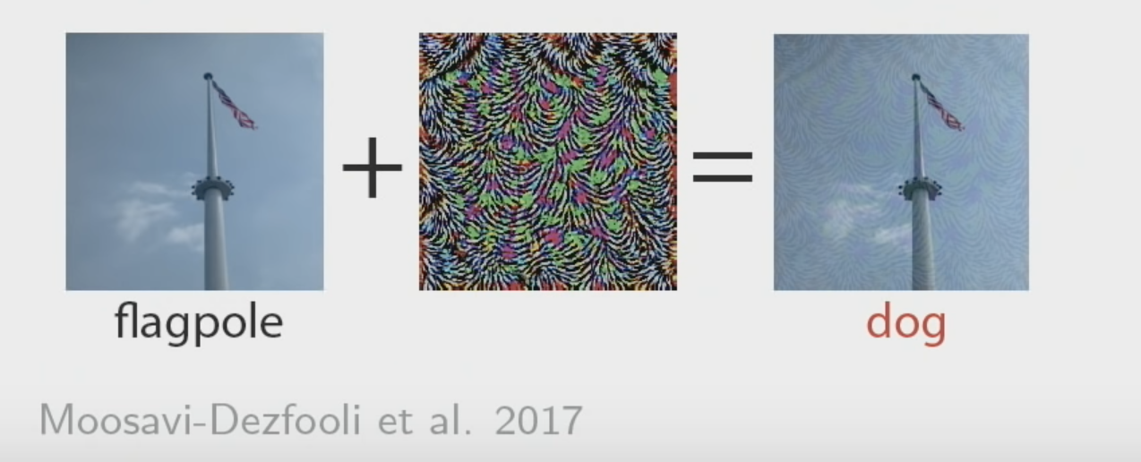
Example
Adding Adversarial Noise on Images makes the Conventional DL Recognition system to Fail

Slide 13
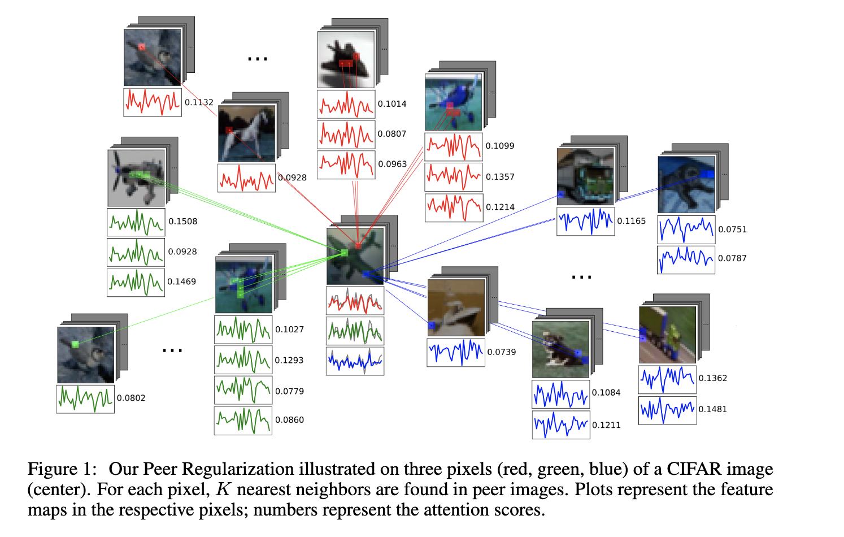
Solution
PeerNets: Exploiting Peer Wisdom Against Adversarial Attacks
A novel family of convolutional networks alternating classical Euclidean convolutions with graph convolutions to harness information from a graph of peer samples

Slide 14
Deep Learning
Functional Estimation Problem
Design Rich Functional Classes (Large Datasets with More Computational Resource)
Low Dimension - Precise mathematical control of Error
High Dimension - No. Of Sample will grow Exponential

Slide 15
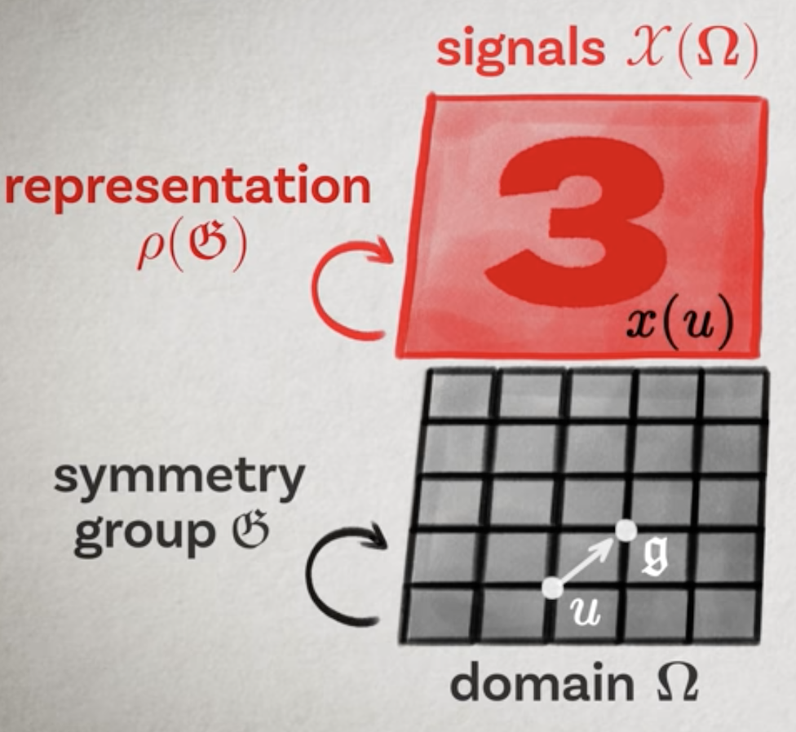
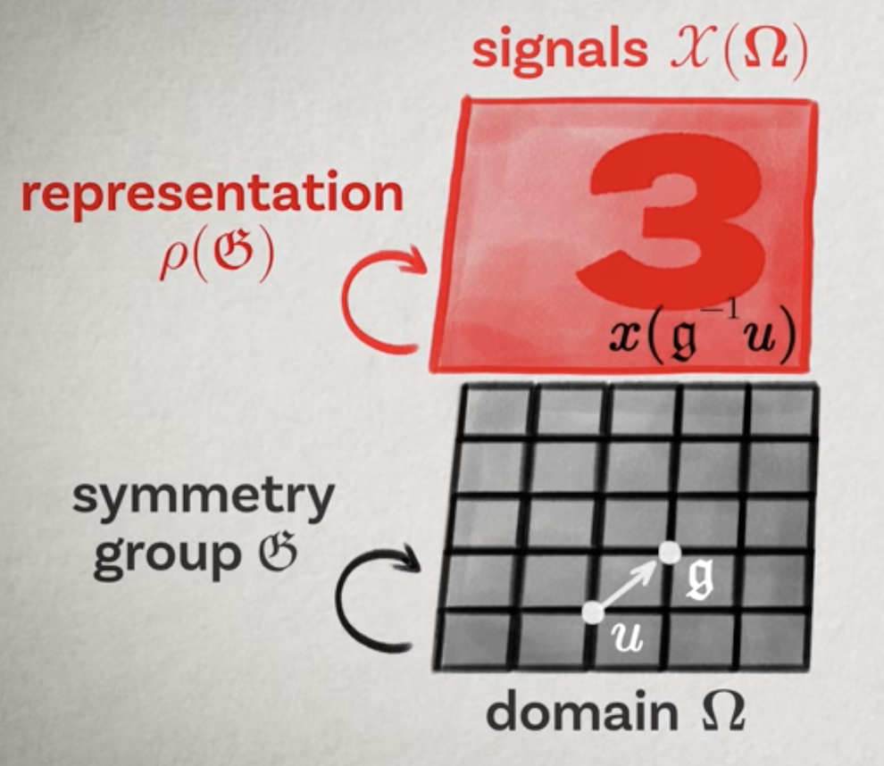
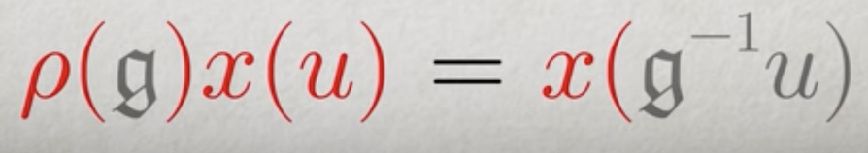
Shift Invariance
Geometric structure of the Input Geometric Prior (Signal Defined of some Domains)

Slide 16
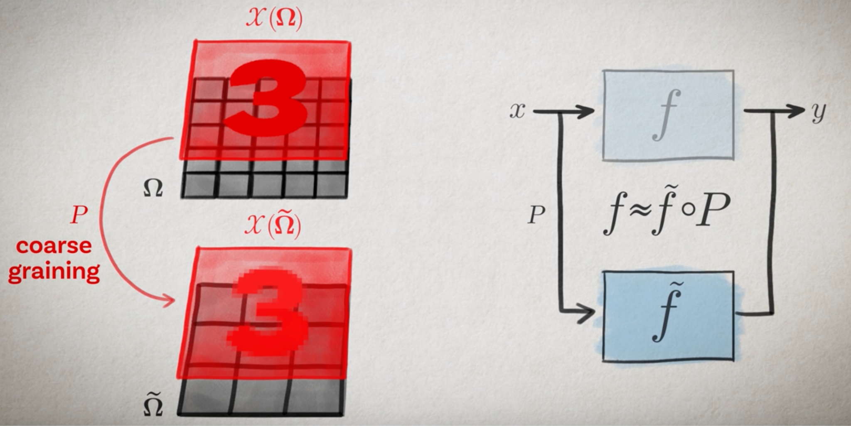
Scale Separation

Slide 17
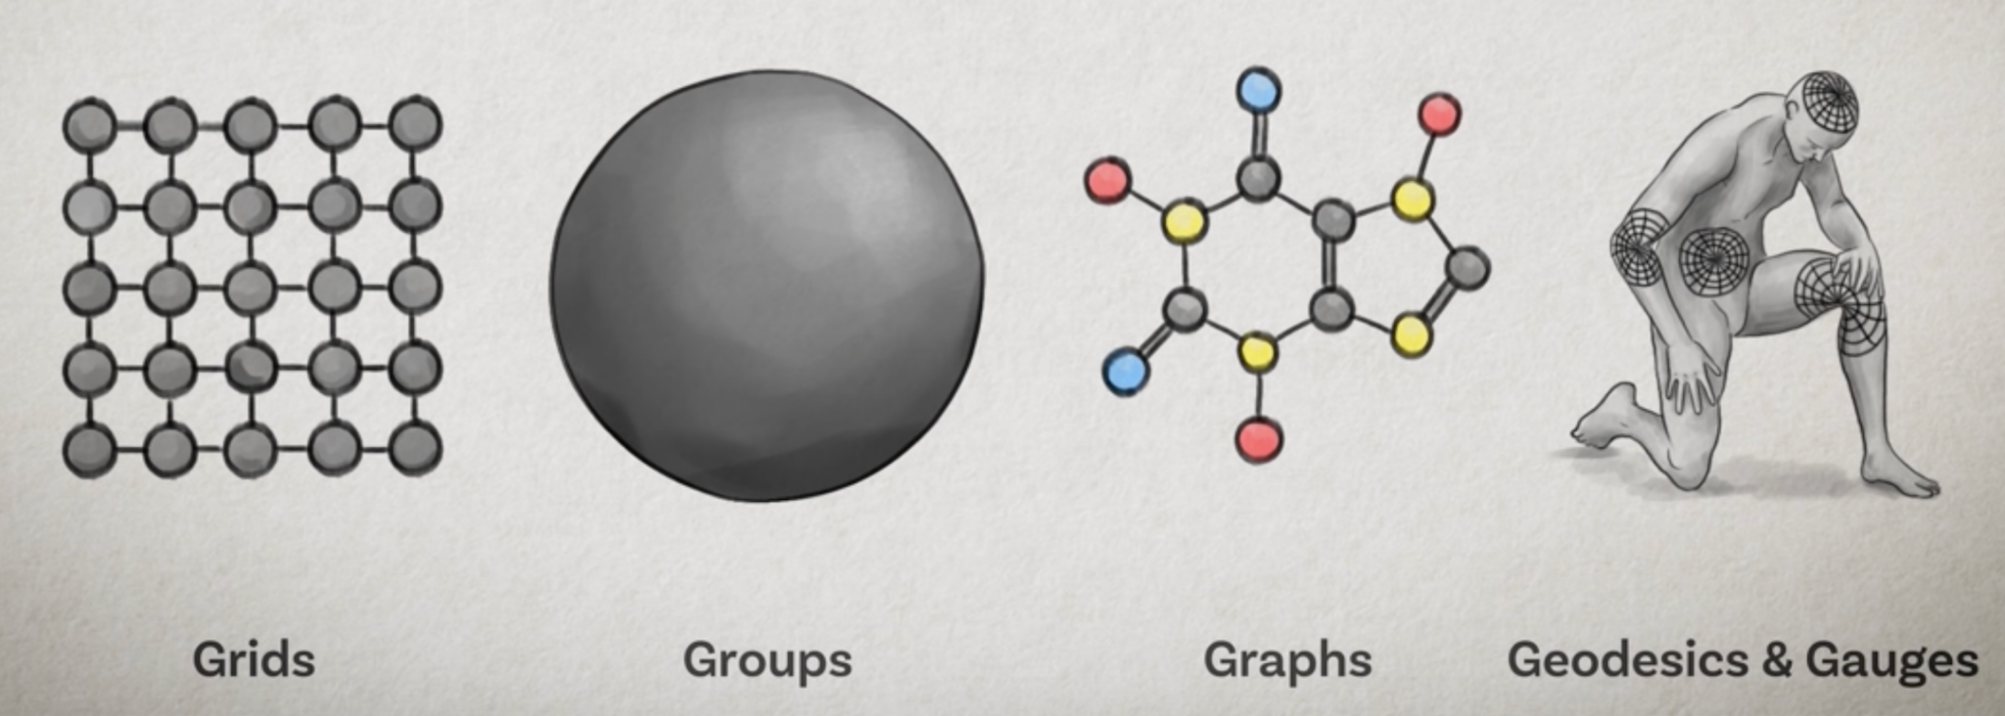
The Above design methods can be applied to Different types of Geometric Structure
5-Gs of Geometric Deep Learning

Slide 18
Graph
Graph, who?
G = (V, E)
Notes:
In Computer Science, a graph is a data structure consist of two components, vertices and edges. A graph G can be well described by the set of vertices V and edges E it contains.

Slide 19
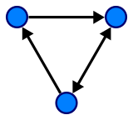
Graph Theory
Graph, who?
G = (V, E)
Notes:
Edges can be either directed or undirected, depending on whether there exist directional dependencies between vertices.

Slide 20
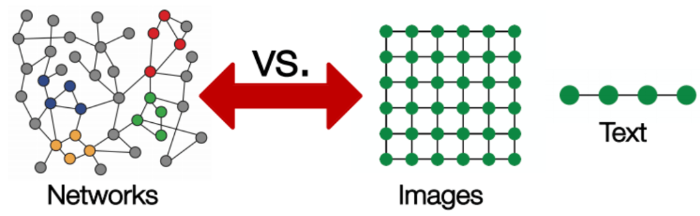
Why is it hard to analyze a graph?
Notes:
Why is it hard to analyze a graph?
Graph data is so complex that it’s created a lot of challenges for existing machine learning algorithms.
The reason is that conventional Machine Learning and Deep Learning tools are specialized in simple data types. Like images with the same structure and size, which we can think of as fixed-size grid graphs. Text and speech are sequences, so we can think of them as line graphs.
But there are more complex graphs, without a fixed form, with a variable size of unordered nodes, where nodes can have different amounts of neighbors.
It also doesn’t help that existing machine learning algorithms have a core assumption that instances are independent of each other. This is false for graph data, because each node is related to others by links of various types.

Slide 21
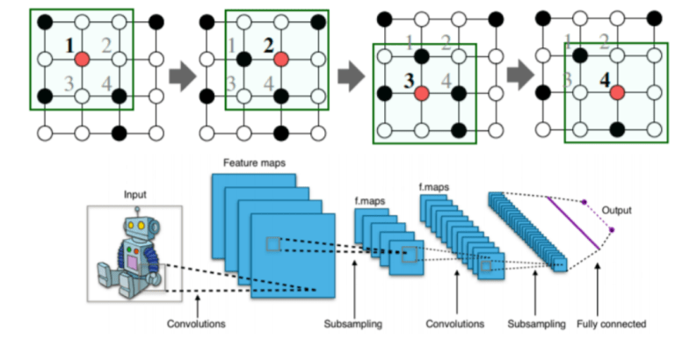
Why do Convolutional Neural Networks (CNNs) fail on graphs?
Notes:
Why do Convolutional Neural Networks (CNNs) fail on graphs?
CNNs can be used to make machines visualize things, and perform tasks like image classification, image recognition, or object detection. This is where CNNs are the most popular.
The core concept behind CNNs introduces hidden convolution and pooling layers to identify spatially localized features via a set of receptive fields in kernel form.
How does convolution operate on images that are regular grids? We slide the convolutional operator window across a two-dimensional image, and we compute some function over that sliding window. Then, we pass it through many layers.
Our goal is to generalize the notion of convolution beyond these simple two-dimensional lattices.
The insight allowing us to reach our goal is that convolution takes a little sub-patch of the image (a little rectangular part of the image), applies a function to it, and produces a new part (a new pixel).
What happens is that the center node of that center pixel aggregates information from its neighbors, as well as from itself, to produce a new value.

Slide 22
Problems
Arbitrary size of the graph
Unfixed node
Notes:
It’s very difficult to perform CNN on graphs because of the arbitrary size of the graph, and the complex topology, which means there is no spatial locality.
There’s also unfixed node ordering. If we first labeled the nodes A, B, C, D, E, and the second time we labeled them B, D, A, E, C, then the inputs of the matrix in the network will change. Graphs are invariant to node ordering, so we want to get the same result regardless of how we order the nodes.

Slide 23
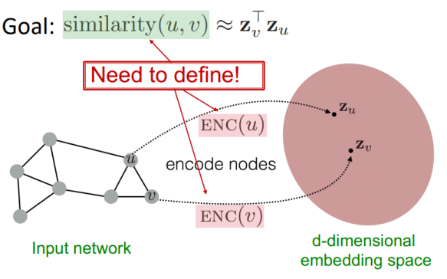
Basics of Deep Learning for graphs
Notes:
Graph Neural Networks (GNNs) are a class of deep learning methods designed to perform inference on data described by graphs.
GNNs are neural networks that can be directly applied to graphs, and provide an easy way to do node-level, edge-level, and graph-level prediction tasks.
GNNs can do what Convolutional Neural Networks (CNNs) failed to do.
In graph theory, we implement the concept of Node Embedding. It means mapping nodes to a d- dimensional embedding space (low dimensional space rather than the actual dimension of the graph), so that similar nodes in the graph are embedded close to each other.
Our goal is to map nodes so that similarity in the embedding space approximates similarity in the network.
Let’s define u and v as two nodes in a graph.
xu and xv are two feature vectors.
Now we’ll define the encoder function Enc(u) and Enc(v), which convert the feature vectors to zu and zv.
the similarity function could be Euclidean distance.

Slide 24
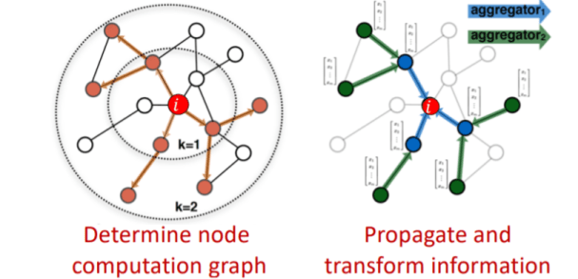
How to come up with the encoder function?
Locality (local network neighborhoods)
Aggregate information
Stacking multiple layers (computation)
Notes:
So the challenge now is how to come up with the encoder function?
The encoder function should be able to perform :
Locality (local network neighborhoods)
Aggregate information
Stacking multiple layers (computation)
Locality information can be achieved by using a computational graph. As shown in the graph , i is the red node where we see how this node is connected to its neighbors and those neighbors’ neighbors. We’ll see all the possible connections, and form a computation graph.
By doing this, we’re capturing the structure, and also borrowing feature information at the same time.
Once the locality information preserves the computational graph, we start aggregating. This is basically done using neural networks.

Slide 25
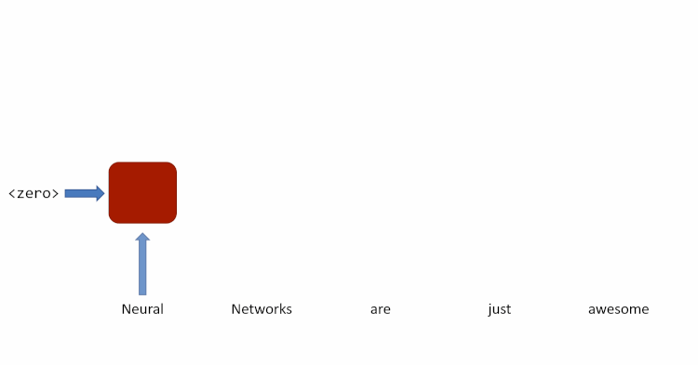
Message Passing
This recurrent simply combines the input — a word for instance — with the output of itself from the previous time-step and passes it through a tanh activation to get the output of the current time-step.
Notes:
To understand the aggregation, let’s first understand what is message passing
we usually address sequences using Recurrent Neural Networks (RNNs). RNNs process each element in the sequence, carrying a state from the previous step to the current step, updating it. The state reflects everything the sequence has shown us so far.
As you can see in the Image :
A recurrent block takes new sequence inputs and its previous state over a few iterations, until it outputs the sentiment analysis of the input text

Slide 26

Message Passing
Replace the state with message, Each element in the sequence updates the message to incorporate information about itself so that the message reflects the information in the sequence as it is processed.
Carried state as a message that’s passed between the sequence elements.
Notes:
In the same situation, you can think of the carried state as a message that's passed along from one sequence element to the next. Each element in the sequence updates the message to incorporate information about itself so that the message reflects the information in the sequence as it is processed.
The same recurrent block as before with its iterations unrolled. We now represent carried state as a message that’s passed between the sequence elements.

Slide 27
Message Passing
length of the sequence = Number of time steps
Essentially, copies of the RNN cell are made over time (unrolling/unfolding), with different inputs at different time steps.
But graphs can be arbitrarily big and flexible.
RNN unfold each time step for a message to collect information about it in its entirety. It might seem as though this is a lot of unnecessary work.
Notes:
If you look carefully, you’ll see that it takes as many steps/elements (called timesteps) as the length of the sequence for a message to collect information about it in its entirety. It might seem as though this is a lot of unnecessary work.

Slide 28
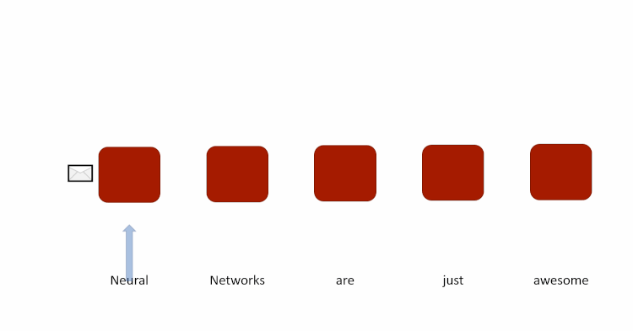
Message Passing
What if an element send a message to the next one on each timestep of the sequence,
Carried state as a message that’s passed between the sequence elements.
Notes:
However, we could have every element send a message to the next one on each timestep of the sequence. This way, the last element would take the same number of timesteps to gather information about the entire sequence.

Slide 29
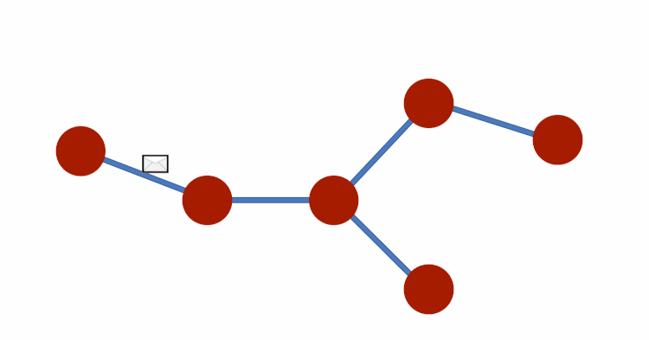
Message Passing
As we applied message passing on sequences, We can apply same idea of message-passing on Graphs
Notes:
Just like we applied the idea of message-passing to sequences, we can also apply it to other kinds of graphs.

Slide 30
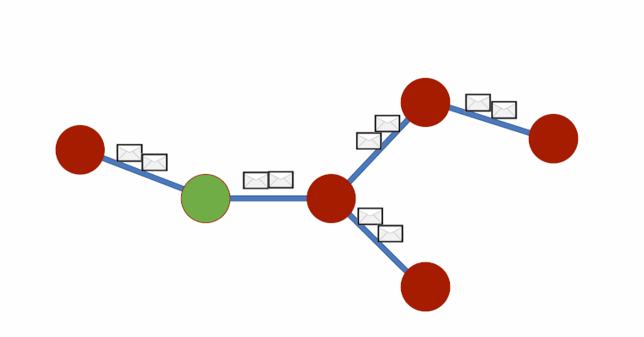
Feature Aggregation
Notes:
In each GCN layer, all nodes are supposed to receive information from neighboring nodes.
Consider each element is passing messages to the elements it connects to — after a few timesteps with exchanges, each node will hold messages that contain information. And, this information within the messages represents an entire graph.
The representation of each node (each row) is now a sum of its neighbors features!

Slide 31
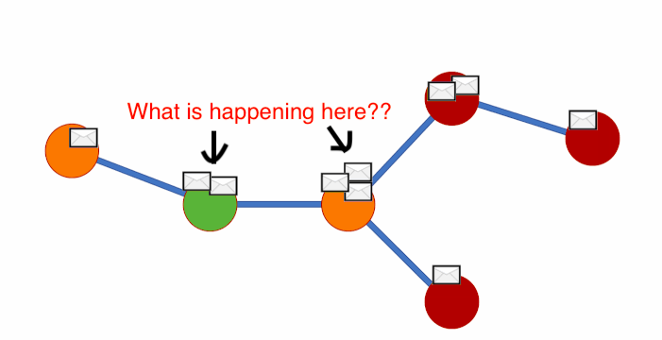
Feature Aggregation
Notes:
Let’s go into detail, What is happening here

Slide 32
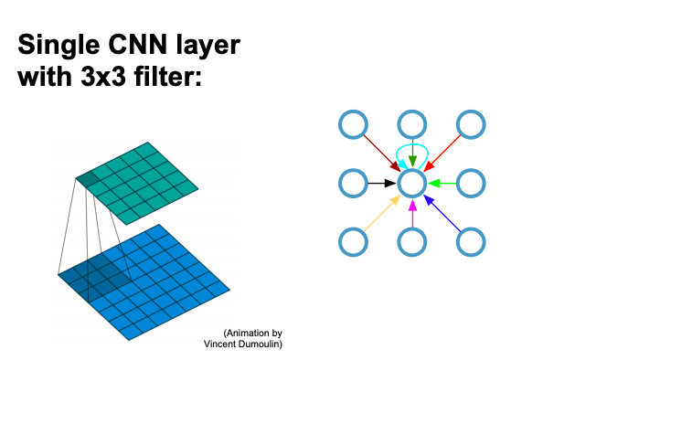
Recap: Convolutional neural networks (on grids)
Notes:
If you remember How CNN works
A convolution filter passes over all the pixels of the image in such a manner that, at a given time, we take ‘dot product’ of the convolution filter and the image pixels to get one final value output. We do this hoping that the weights (or values) in the convolution filter, when multiplied with corresponding image pixels, gives us a value that best represents those image pixels. We can think of each convolution filter as extracting some kind of feature from the image.

Slide 33
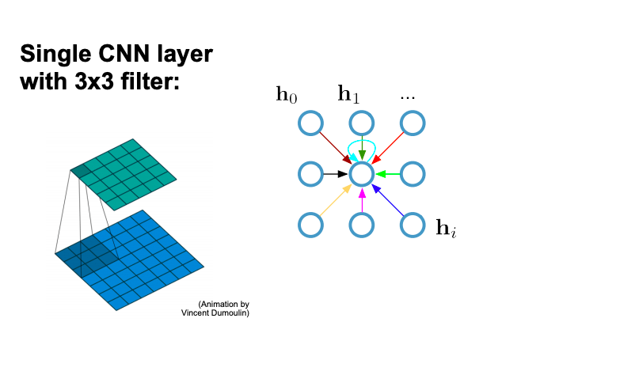
Recap: Convolutional neural networks (on grids)
Notes:
Same like that instead of Image we apply filter on Nodes..

Slide 34
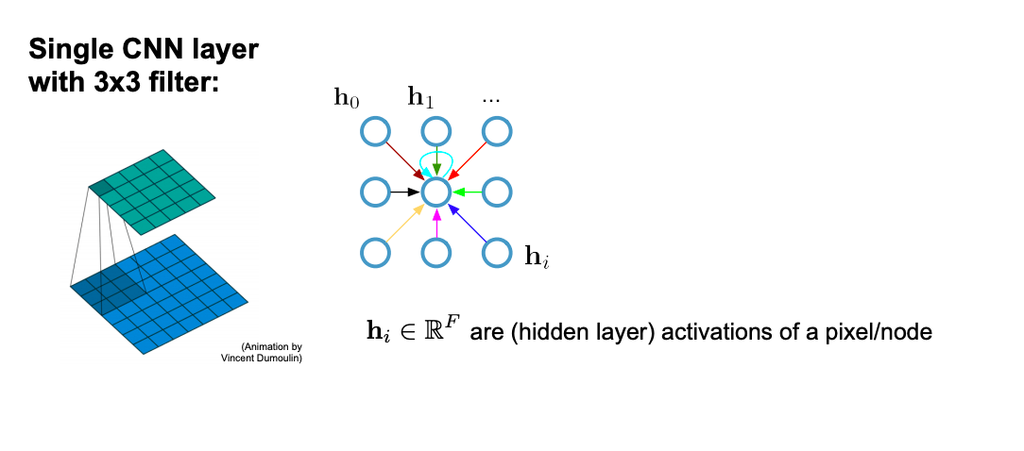
Recap: Convolutional neural networks (on grids)
Notes:
Every node consist of A d-dimentional feature vector

Slide 35
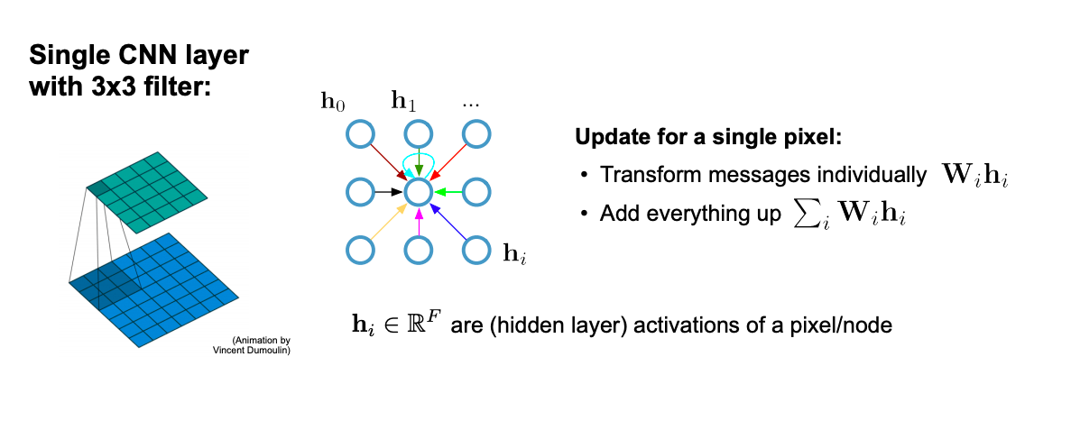
Recap: Convolutional neural networks (on grids)
Notes:
Same as CNN filter, In GCN After every message passion, Each node sum up all the information from it’s neighbours node

Slide 36
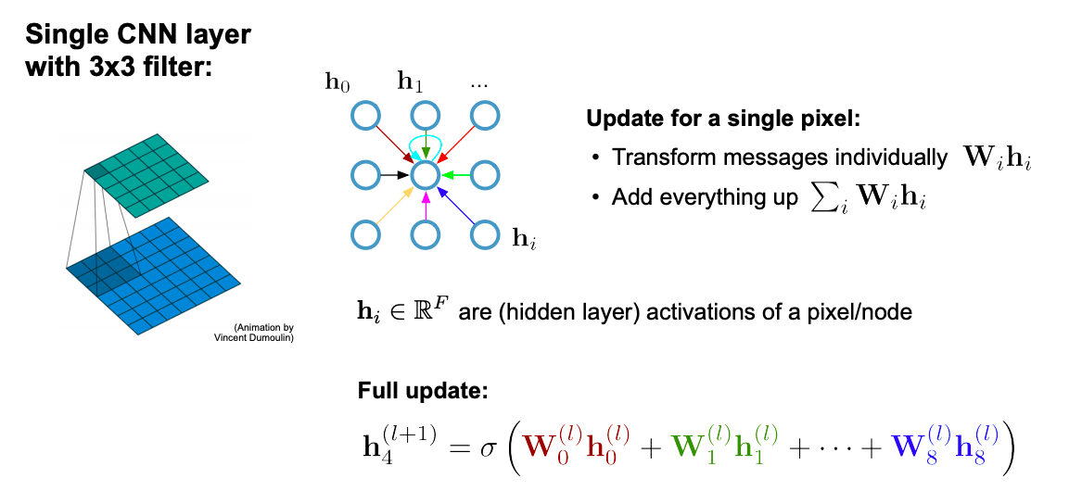
Recap: Convolutional neural networks (on grids)
Notes:
Here is full updateby summing up all the gathered information from neighbours.

Slide 37
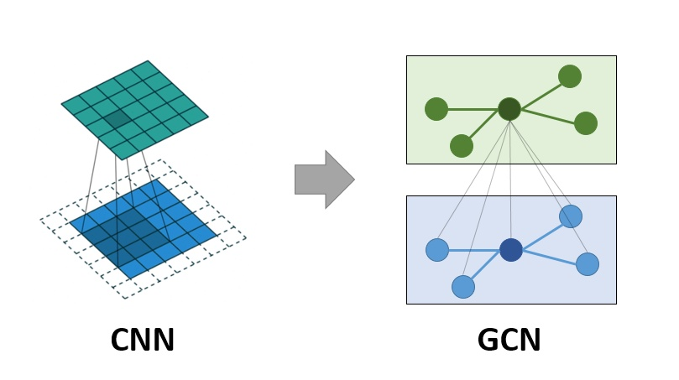
Comparing
Notes:
i think, Now we can compare easily, the left side is CNN filter and right side is node filter in GCN

Slide 38
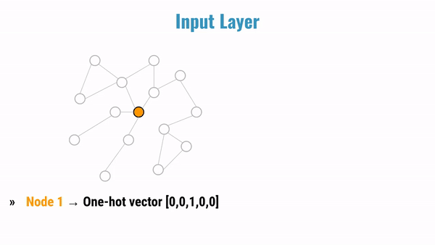
Animations are good..
Notes:
Animations are good.. as you can see blue nodes are one hop and green nodes are second hop neighbours,
It’s aggregating information from one hop
Summing up
Now aggregating from second hop information

Slide 39
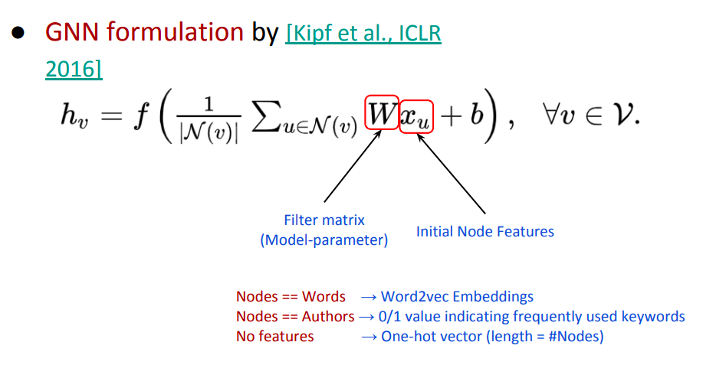
Formulation
Notes:
So, let;s understand the math behind the GCN formula
The formula presented in paper titled Semi-Supervised Classification with Graph Convolutional networks by thomas kipf. Where W is the filter matrix and x are the feature of graph data.

Slide 40
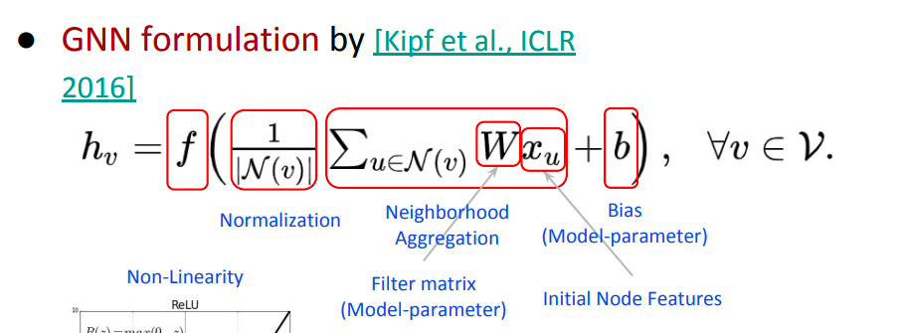

Formulation
Notes:
As we can see in the formula, First we do normalization, then aggregate the neighbors features by multiplying feature matrix with weight or filter matrix, later add the bias.

Slide 41
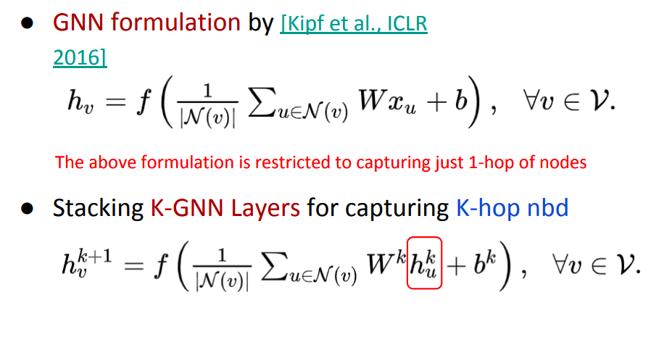
Formulation
Notes:
Here is full formula, this GCN layer is limited to capturing only one hop features of neighbours nodes, later part of formula we are stacking k gnn layers to capture k hop neighbour features

Slide 42
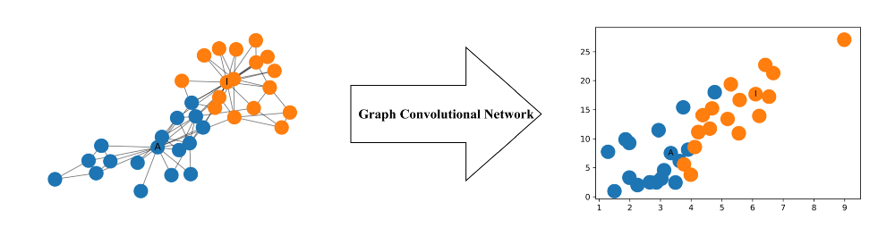
Hello World in Deep Learning on Graph
Let’s Understand by practical examples :
Notes:
we’ll take a very simple example to understand inner working of network

Slide 43
Hello World in Deep Learning on Graph
Given a graph G = (V, E), a GCN takes as input
An input feature matrix N × F⁰ feature matrix, X, where N is the number of nodes and F⁰ is the number of input features for each node
N × N matrix representation of the graph structure such as the adjacency matrix A of G.
Notes:
GCN takes a input feature matrix shape of n x f where number of nodes and f is the number of input features
and n x n adjacency matrix

Slide 44
Hello World in Deep Learning on Graph
A Simple Propagation Rule
Notes:
where Wⁱ is the weight matrix for layer i and σ is a non-linear activation function such as the ReLU function. The weight matrix has dimensions Fⁱ × Fⁱ ⁺¹; in other words the size of the second dimension of the weight matrix determines the number of features at the next layer. this operation is similar to a CNN’s filtering operation since these weights are shared across nodes in the graph.

Slide 45
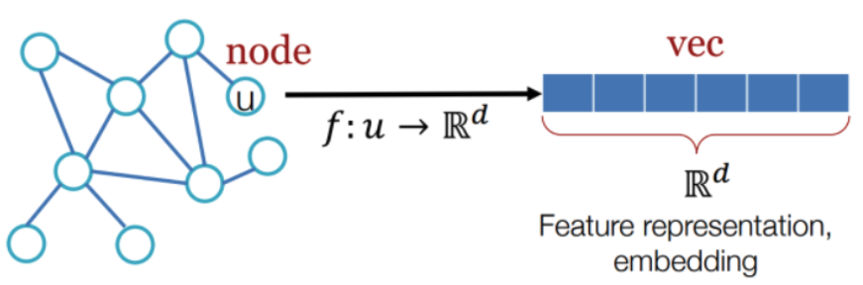
Hello World in Deep Learning on Graph
Every Node is a vector of d dimension
Notes:
Every Node is a vector of d dimension

Slide 46
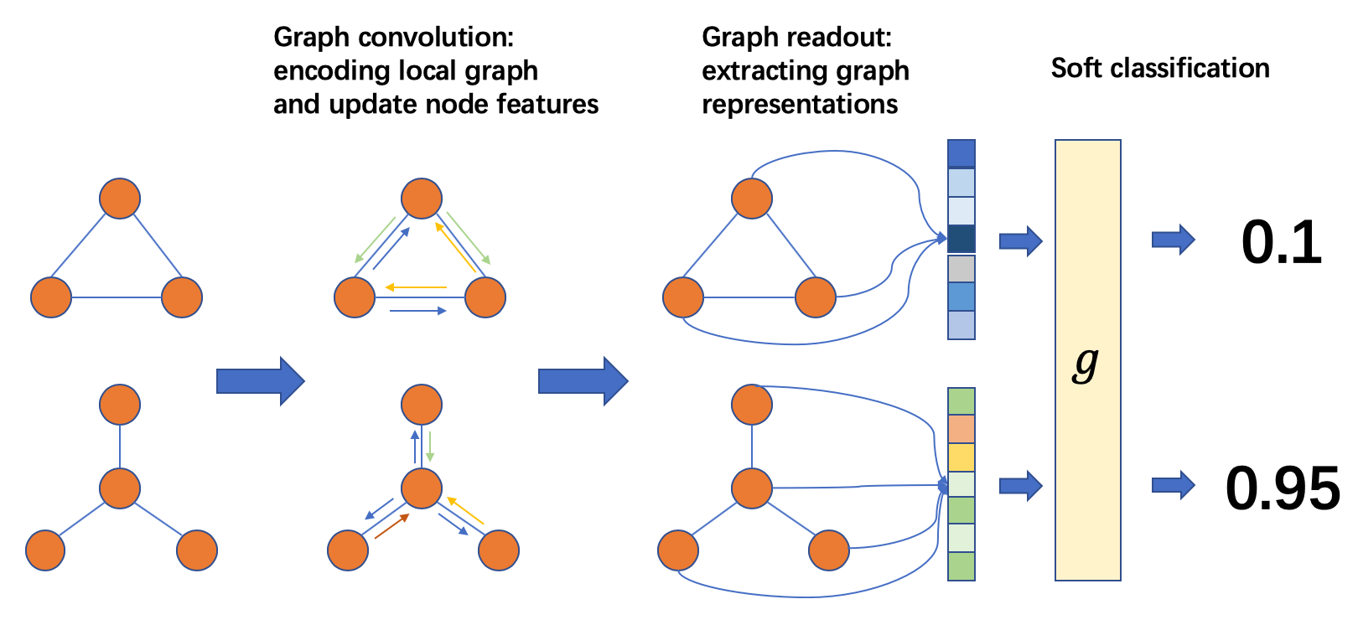
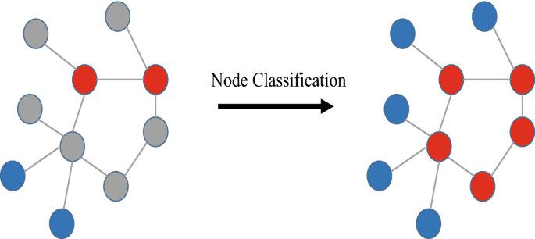
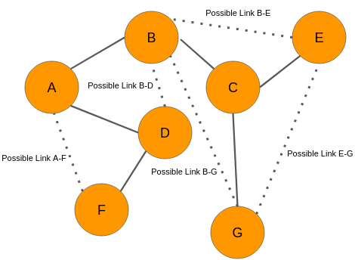
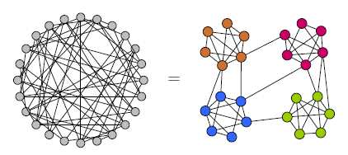
Application of GNN
Graph Classification
Node Classification
Link Prediction
Graph Clustering

Slide 47
Example
Jupyter Notebook explanation : Notebook 1
https://tinyurl.com/gcn-formulation
Notes:
Let’s see the practical example

Slide 48
Key Points from Notebook
In Graph based Models, using the Adjacency Matrix(A) enables the model to learn the features of neighboring nodes.
Thomas Kipf and Max Welling (2017) Used the Renormalization trick to normalize the features in Fast Approximate Spectral-based Graph Convolutional Networks.
GCNs can learn features representation to cluster even before training.
Notes:
so the key points from the notebook are
In Graph based Models, using the Adjacency Matrix(A) enables the model to learn the features of neighboring nodes.
Thomas Kipf and Max Welling (2017) Used the Renormalization trick to normalize the features in Fast Approximate Spectral-based Graph Convolutional Networks.
GCNs can learn features representation to cluster even before training.

Slide 49
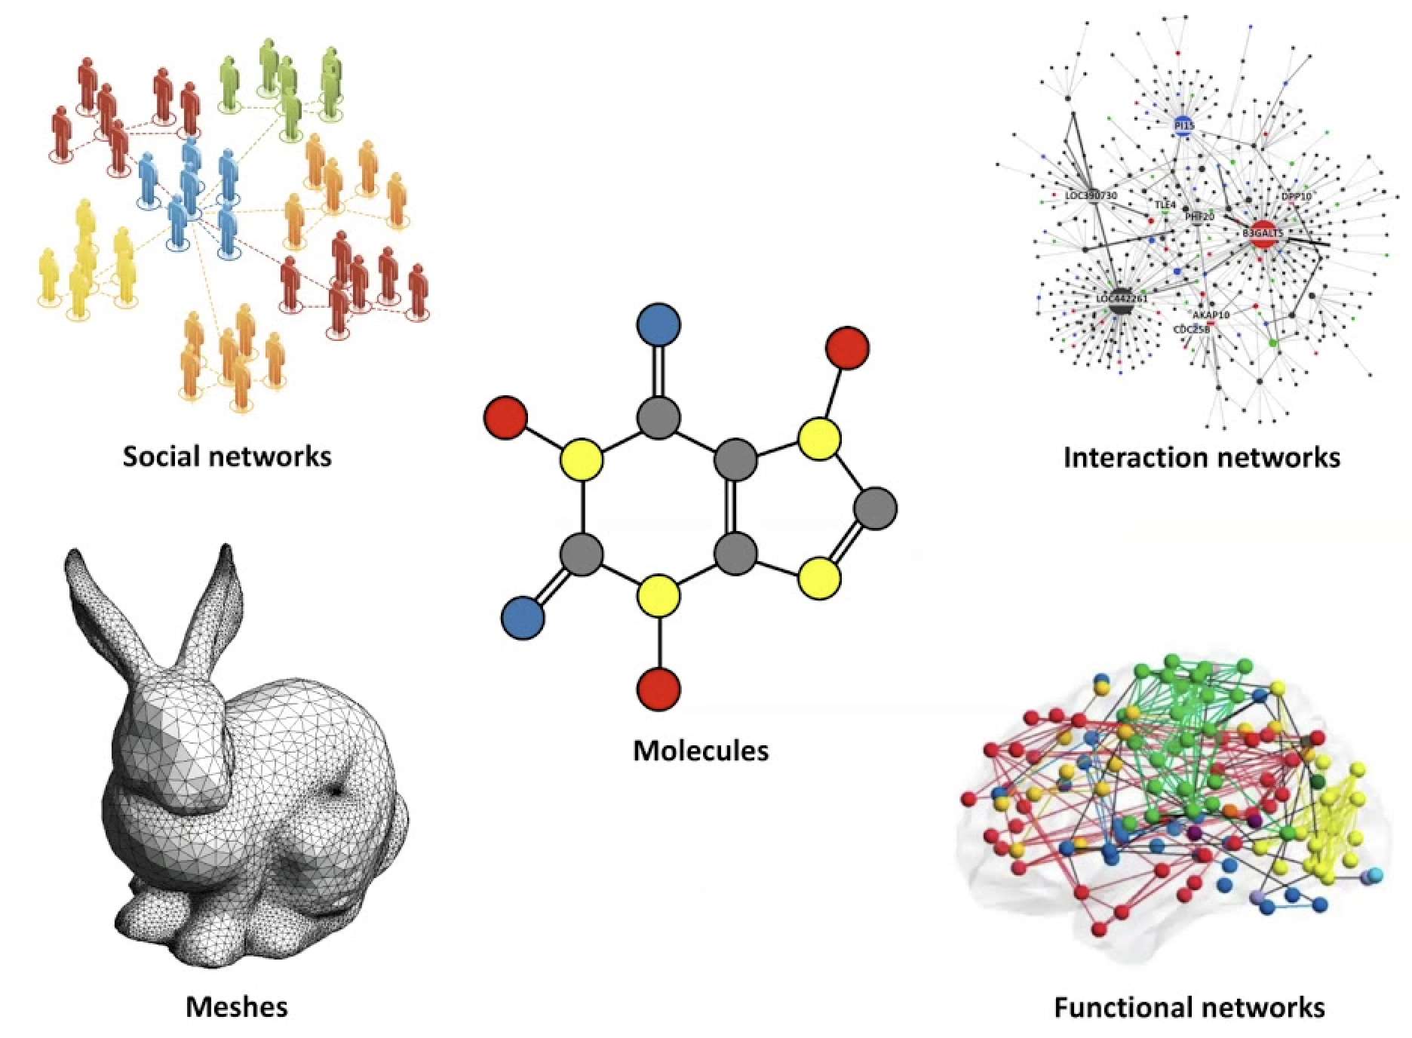
Applications of Geometric Deep Learning
Notes:
Graph-structured data is present everywhere. The problems that GNNs resolve can be classified into these categories:

Slide 50
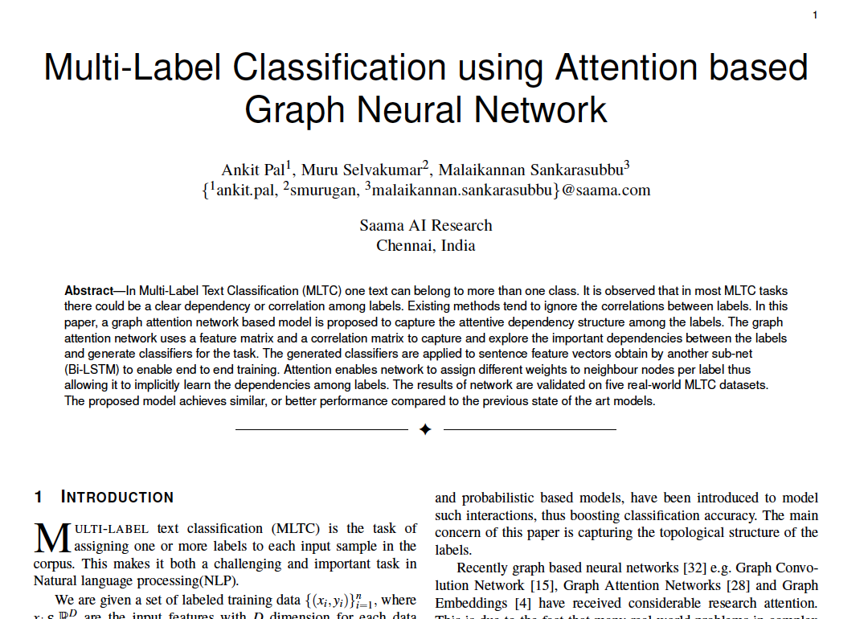
MAGNET : Multi-Label Text Classification using Attention-based Graph Neural Network
Applications
https://www.groundai.com/project/multi-label-text-classification-using-attention-based-graph-neural-network/1
Notes:
This is second paper in this series, We published this paper in 2020.
Key Points of Research Paper
Using Graph Attention Network (GAT) as Feature extractor
Constructing a graph between labels of dataset
The graph attention network uses a feature matrix and a
correlation matrix to capture and explore the crucial
dependencies between the labels.
The generated classifiers are applied to sentence feature
vectors obtained from the text feature extraction network
(Bi-LSTM) to enable end-to-end training.

Slide 51
Credits
Extra Credits: The History of Non-Euclidean Geometry
Michael Bronstein: Geometric Deep Learning: Going beyond Euclidean data, Geometric Deep Learning Grids, Groups, Graphs, Geodesics, and Gauges
Ankit Kumar Pal: MAGNET

